Slide 1
QRM Final
LI LIPING(A0186040M)

Slide 2
Introduction and problem description
In this presentation, we mainly covered the metals price forecast using time series analysis technique and risk averse decision making using cvar

Slide 3
Statistical analysis

Slide 4
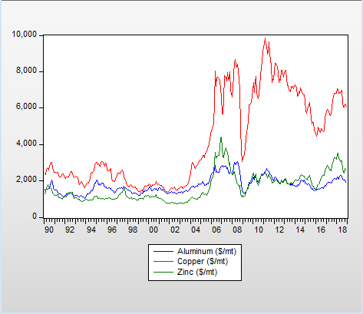
From the visualization, the series of three metals are all not stationary.

Slide 5
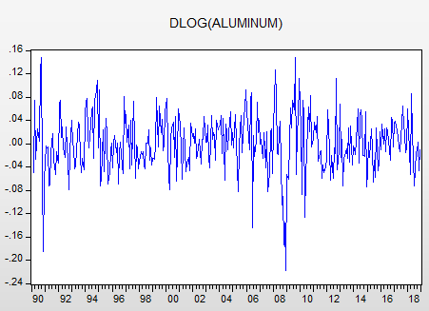
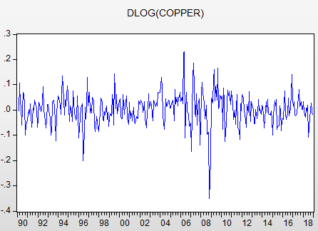
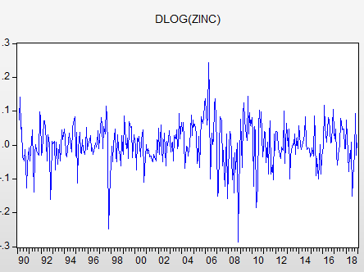
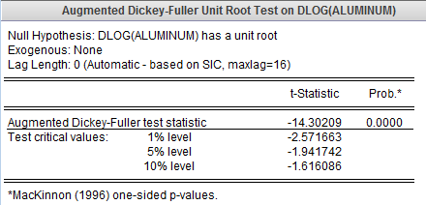
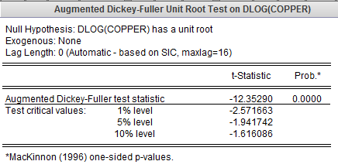
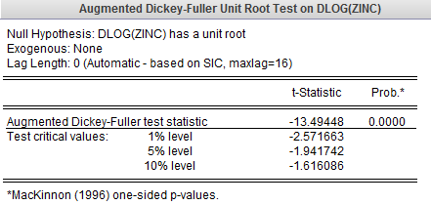
Augmented Dickey-Fuller test
From the augmented Dickey-Fuller test, after Dlog, the series are all stationary.

Slide 6
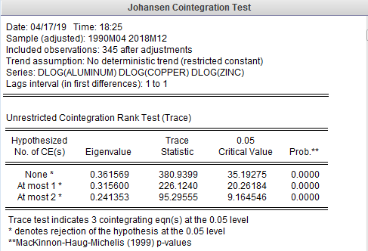
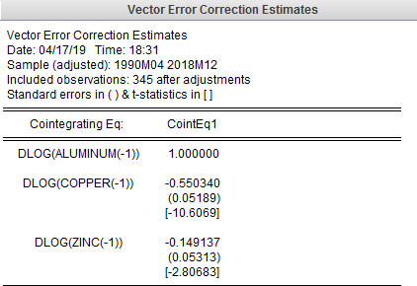
COINTEGRATION TEST
Conclusion: There is at most 2 cointegrating equation in the system of three metal prices
We got the following cointegration equation
dlog (aluminum −1) = 0.55dlog (copper−1 ) + 0.15dlog (zinc −1 )

Slide 7
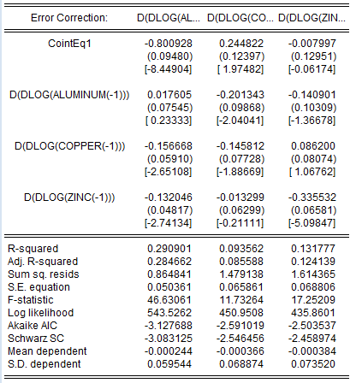
Aluminum price has significant effect on copper price. Aluminum price is affected by copper and zinc.
Copper price has significant effect on aluminum price only. copper price is only affected by aluminum.
Zinc price has significant effect on aluminum and zinc. Zinc price is only affected by zinc.
Zinc is the main driver, cause it affect aluminum and zinc prices

Slide 8
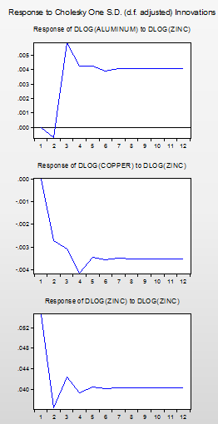
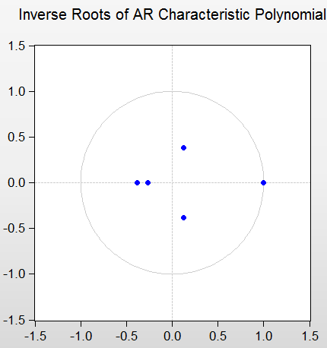
AR roots graph & Impulse graph
DLog(Aluminum) response to DLog (Zinc) first decrease then increase during the first three months. Then it reversed the impact slightly toward the end of 6 months, then it quite off to the end of 12 month
DLog(copper) response to decrease in DLog(Zinc) demonstrates a strong impact in the first 4 months, then it quite off to the end of 12 month
DLog(Zinc) response to increase in DLog(Zinc) follows almost the same pattern as for copper and Zinc price. But in the middle of 2nd to 4th month, the impact fluctuate a little bit
All points are inside the circle so the result is safe and not explosive.

Slide 9
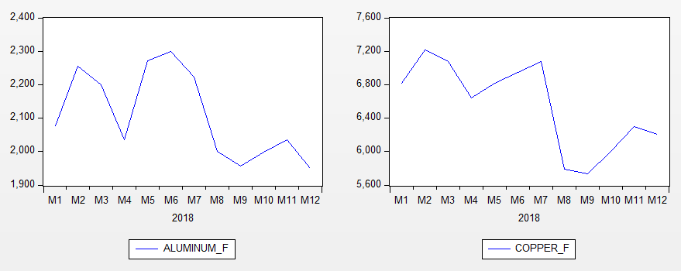
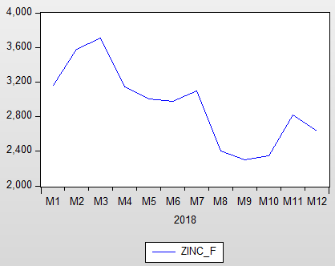
Forecast
Following from conclusion earlier, zinc’s price is the main driver in this system. Zinc’s price is predicted to fluctuate rapidly during 2018, so the price of aluninum and copper also fluctuate with zinc.

Slide 10
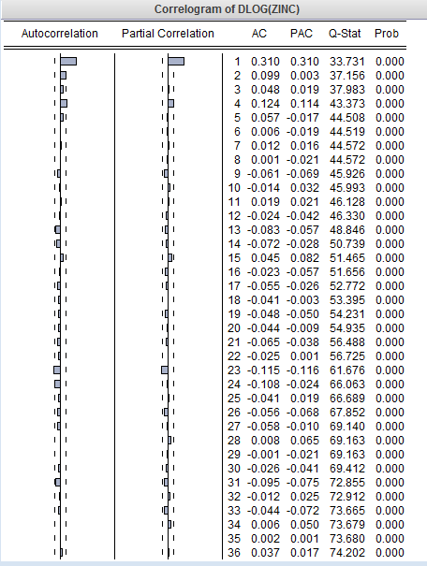
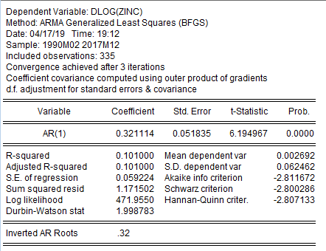
Focusing on the ARIMA model of zinc’s price
This is the best model I picked

Slide 11
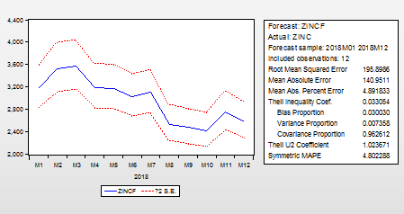
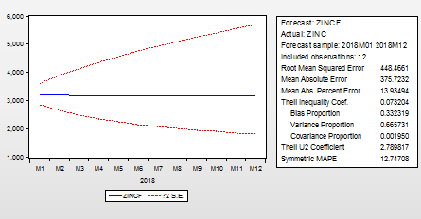
For static forecast in 2018
Theil Inequality Coefficient: 3.3% indicates a very good fit.
Bias Proportion: 3%
the forecast for the mean are very close to the actual values.
Variance Proportion: 0.7%
the variance of the forecasts is almost perfect! This is due to modelling seasonal behavior.
Covariance Proportion: 96.3%
a big proportion of forecasting errors are unsystematic.
And the forecast from the dynamic forecast is also very good since the Theil Inequality Coefficient is 7.3%

Slide 12
Risk Aversion

Slide 13

Mathematical model of CVAR
$$\operatorname{Minimize}{cvar}$$
s.t $\sum_{i=1}^{3}{x\left(i\right)=1}$
$$\sum_{i=1}^{3}{mean\left(i\right)∗x\left(i\right)≥0.003}$$
$$z\left(s\right)≥−\sum_{i=1}^{3}{a\left(i,s\right)∗x\left(i\right) − var}$$
$$cvar=var+\frac{\sum_{s=1}^{1000}{z(s)}}{\left(\left(1−beta\right)∗card\left(s\right)\right)}$$
$$x\left(i\right), z(s)≥0$$

Slide 14
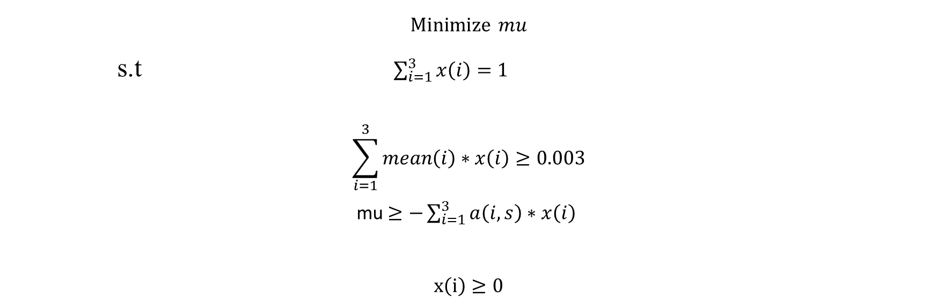
Mathematical model of worst case
$$\operatorname{Minimize}{mu}$$
s.t $\sum_{i=1}^{3}{x\left(i\right)=1}$
$$\sum_{i=1}^{3}{mean\left(i\right)∗x\left(i\right)≥0.003}$$
mu $≥−\sum_{i=1}^{3}{a\left(i,s\right)∗x\left(i\right) }$
$$x\left(i\right)≥0$$

Slide 15
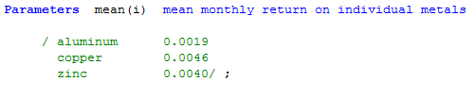
Parameters
Calculate the returns based on the monthly data, which is the ${(P}_{t+1}$-${ P}_{t}$ )/ $P_{t}$, then compute the variance covariance
Matrix and correlation matrix, we set out objective return as 0.003
variance-covariance matrix
correlation matrix
 | Aluminum | Copper | Zinc
Aluminum | 0.2383 | 0.1933 | 0.1644
Copper | 0.1933 | 0.3804 | 0.2368
Zinc | 0.1644 | 0.2368 | 0.3854
 | Aluminum | Copper | Zinc
Aluminum | 1.0000 | 0.8232 | 0.7925
Copper | 0.8232 | 1.0000 | 0.8182
Zinc | 0.7925 | 0.8182 | 1.0000

Slide 16
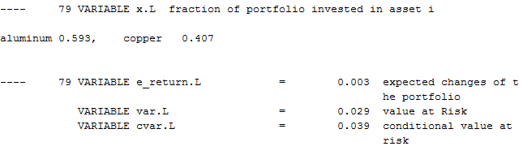
Optimal policy under scenarios=1000, beta=0.9
As the graph shown above, the optimal policy is to spend 59.3% budget buying aluminium and 40.7% buying copper. The corresponding var is 0.029 and cvar is 0.039 at this case.

Slide 17
Sensitivity analysis
1. Scenario = 1000
 |  | CVAR | CVAR | CVAR | CVAR | Worst Case
Scenario |  | 1000 | 1000 | 1000 | 1000 | 1000
Beta |  | 0.9 | 0.95 | 0.99 | 0.999
Mix
 | aluminum | 59.30% | 58.70% | 57.70% | 58.20% | 58.20%
 | copper | 40.70% | 38.60% | 35.30% | 37.00% | 37.00%
 | zinc |  | 2.70% | 7.00% | 4.80% | 4.80%
return |  | 0.003 | 0.003 | 0.003 | 0.003 | 0.003
V@R |  | 0.029 | 0.036 | 0.054 | 0.073
CV@R |  | 0.039 | 0.046 | 0.063 | 0.073
Mu |  |  |  |  |  | 0.073

Slide 18
2. Scenario = 5000
 |  | CVAR | CVAR | CVAR | CVAR | Worst Case
Scenario |  | 5000 | 5000 | 5000 | 5000 | 5000
Beta |  | 0.9 | 0.95 | 0.99 | 0.999
Mix
 | aluminum | 59.30% | 59.30% | 59.30% | 59.30% | 57.70%
 | copper | 40.70% | 40.70% | 40.70% | 40.70% | 35.30%
 | zinc |  |  |  |  | 7.00%
return |  | 0.003 | 0.003 | 0.003 | 0.003 | 0.003
V@R |  | 0.03 | 0.039 | 0.057 | 0.082
CV@R |  | 0.042 | 0.05 | 0.065 | 0.084
Mu |  |  |  |  |  | 0.087

Slide 19
3. Scenario = 10,000
 |  | CVAR | CVAR | CVAR | CVAR | Worst Case
Scenario |  | 10000 | 10000 | 10000 | 10000 | 10000
Beta |  | 0.9 | 0.95 | 0.99 | 0.999
Mix
 | aluminum | 59.30% | 59.30% | 59.30% | 58.30% | 59.30%
 | copper | 40.70% | 40.70% | 40.70% | 37.30% | 40.70%
 | zinc |  |  |  | 4.40%
return |  | 0.003 | 0.003 | 0.003 | 0.003 | 0.003
V@R |  | 0.003 | 0.039 | 0.057 | 0.075
CV@R |  | 0.042 | 0.05 | 0.064 | 0.081
Mu |  |  |  |  |  | 0.101

Slide 20
Conclusions:
• Keeping the scenario still, with the increase of beta, V@R and CV@R will converge to worst case. And V@R is always less or equal than CV@R
• V@R and CV@R converge to worst case mu faster when the scenario is less, in other words, the distance between CV@R and worst mu with beta 0.999 under scenario 10,000 is larger than the distance between CV@R and worst mu with beta 0.999 under scenario 1,000.
• The larger the scenarios are, the higher the worst-case return.
• The V@R and CV@R increase with the increase of beta.
CVAR is very sensitive is to the number of scenarios: If we use more scenarios the results will be more consistent and it will give us a meaningful read between betas. But if we have very few scenarios the results less consistent. Expected values will not be impacted materially by the number of scenarios.

Slide 21
Originality of the topic and analysis
This topic is derived from the portfolio management. Although we can’t treat metals as some kind of
Securities. But the derivatives from metals these days are very popular, so it’s also meaningful to treat this
Project as a portfolio management problem
And this project covered the part in time series analysis and also the part in risk aversion. It’s a combination of
Methods to deal with risk management problems

